Slide 1

Final Data science project
Jose Neelettu

Slide 2
Library used
Tidy verse
WorldCupMatches

Slide 3
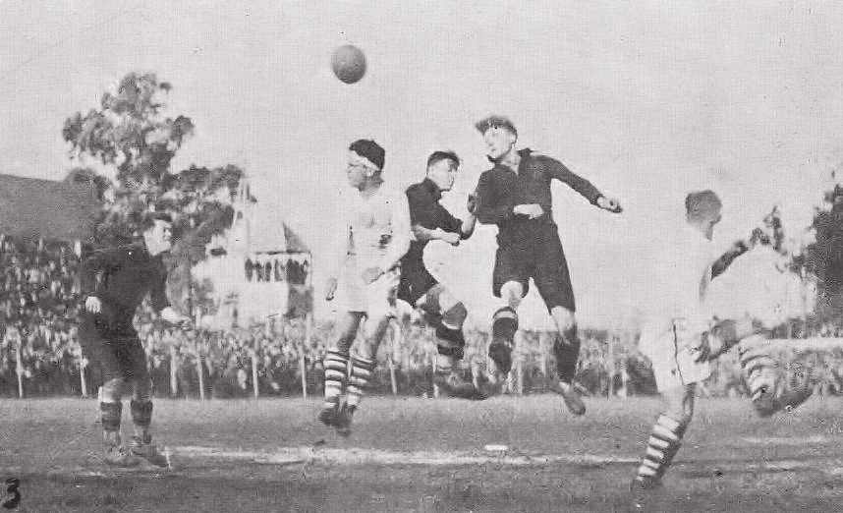
Introduction
My project is based on the World Cup matches from 1930 to 2014. This dataset includes information on all the World Cup Matches from 1930 to 2014
The data fields included are: Year, Datetime, Stage,
Stadium, City, home team goals, Away team goals,
Away team name, Win conditions, attendance, Half
time home goals, Half time Away Goals, Referee,
Assistant.1, Assistant.2, RoundID, MatchID, Home Team Initials,
Away Team Initials
This Photo by Unknown Author is licensed under CC BY-SA

Slide 4

My focus
Between Portugal and Argentina, which team from 1930 to 2014 had the best performance.
This Photo by Unknown Author is licensed under CC BY

Slide 5
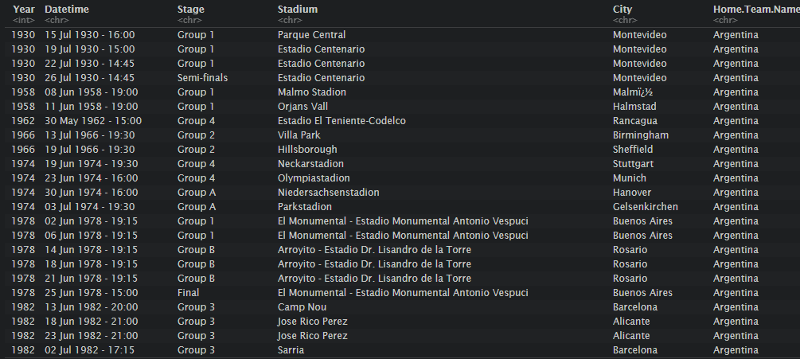
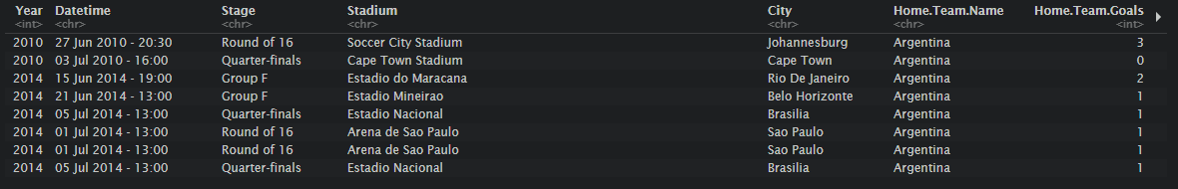
Argentina Stats
Argentina started playing from 1930 and played all the way through 2014.

Slide 6
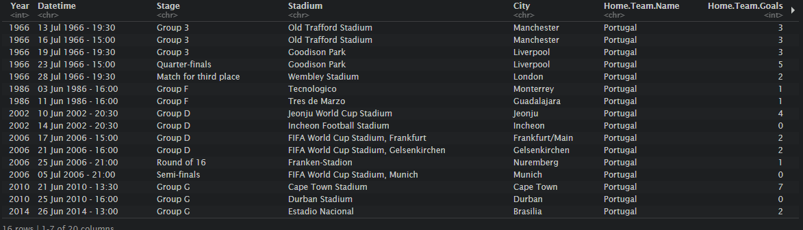
Portugal Stats
However, Portugal only started playing from 1966. So, their stats have a huge difference from Argentina. But in the next few slides we will compare them fairly.

Slide 7
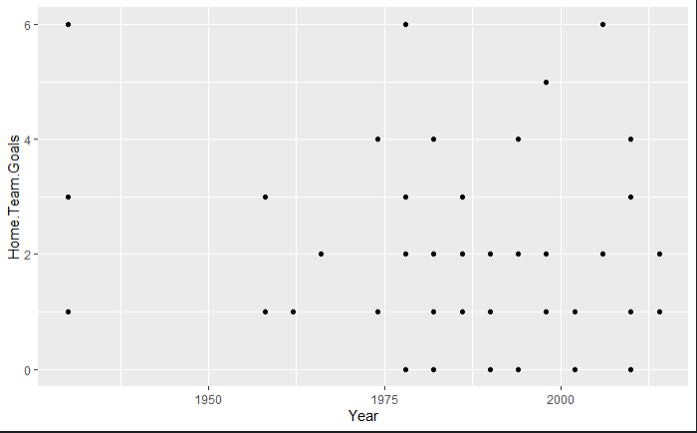

Argentina’s Home Team goals throughout the year
So I made a ggplot to find all the goals made by Argentina throughout the years.

Slide 8
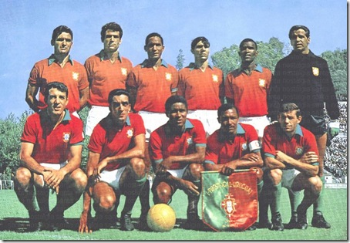
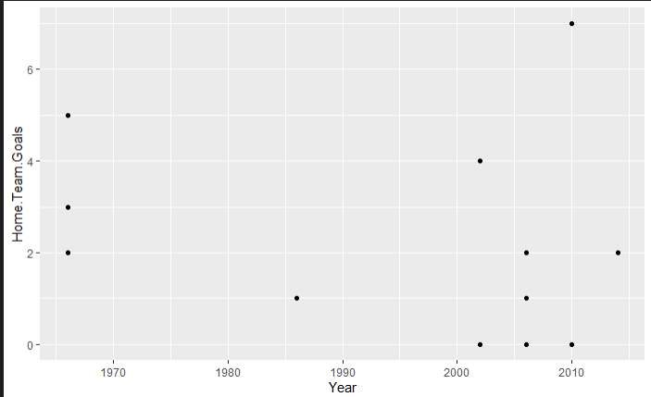
Portugal Home Team goals throughout the year
Since Portugal didn’t come into the World Cup until 1966. They were behind Argentina by a lot.
This Photo by Unknown Author is licensed under CC BY-NC-ND

Slide 9

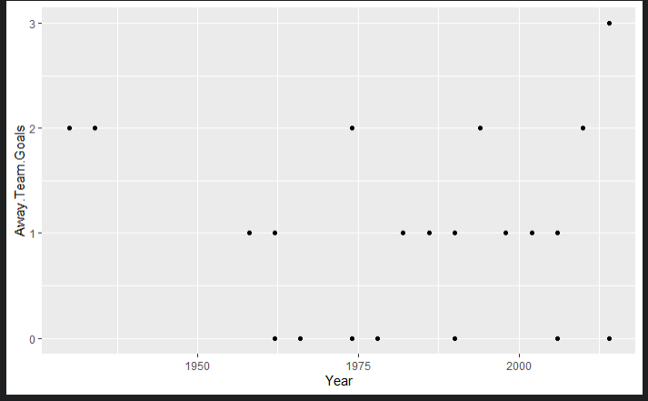
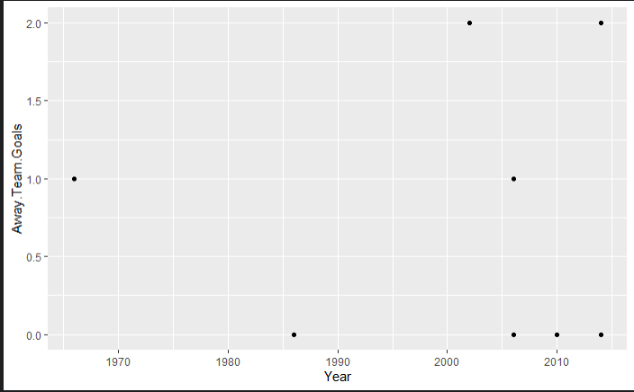
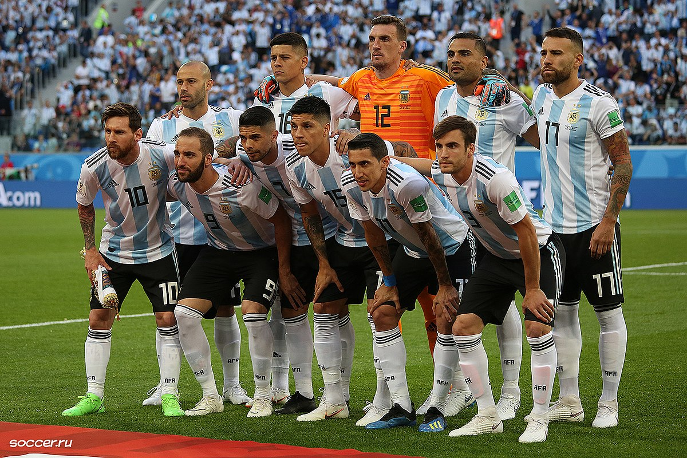
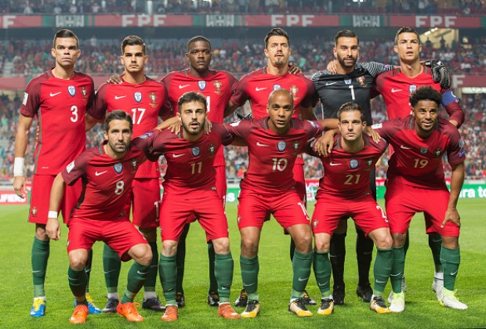
Argentina’s Away Team goals throughout the year
Now I will go into the away goals for Argentina and Portugal
This Photo by Unknown Author is licensed under CC BY-SA
This Photo by Unknown Author is licensed under CC BY-NC-ND

Slide 10
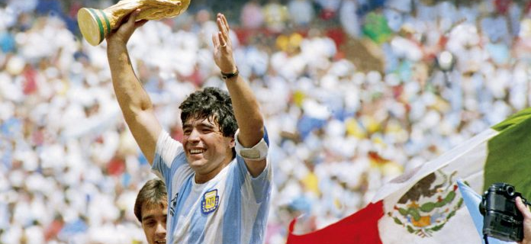

Conclusion
So, in conclusion we can tell that Argentina had an advantage over Portugal for starting earlier, But Argentina still had way more even if you compared them from 1966.

